Slide 1
CREDIT EDA CASE STUDY
Presented by –
Harsha Dutta B S
Sai Rajesh Nalamati

Slide 2
TABLE OF CONTENTS
Our understanding of the Business requirements
Scope of the project
Solution Architecture
Solution Approach
Key Insights & Our Recommendations
List of Variables which can be used for developing a Machine Learning Model in the future

Slide 3





OUR UNDERSTANDING OF BUSINESS REQUIREMENTS
The case study aims to identify patterns which indicate if a client has difficulty paying their instalments which may be used for taking actions such as denying the loan, reducing the amount of loan, lending (to risky applicants) at a higher interest rate, etc. This will ensure that the consumers capable of repaying the loan are not rejected. Identification of such applicants using EDA is the aim of this case study.
It also focuses on understanding the driving factors (or driver variables) behind loan default, i.e. the variables which are strong indicators of default.
The main aim of this case study is to enhance the company’s business portfolio and target successful risk assessment.
We are expected to use EDA to understand how consumer attributes and loan attributes influence the tendency of default.

Slide 4

SCOPE OF THE PROJECT
Present the overall approach of the analysis by mentioning the problem statement and the analysis approach briefly.
Identify the missing data and use appropriate method to deal with it. (Remove columns/or replace it with an appropriate value)
It is not necessary to replace the missing value in EDA. But if you have to replace the missing value, what should be the approach used?
Identify the outliers & cause for the same in the dataset.
Identify if there is data imbalance in the data. Find the ratio of data imbalance.
Explain univariate, segmented univariate, bi-variate analysis, etc. In business terms.
Find the top 10 correlation for the client with payment difficulties and all other cases (target variable).
Include visualisations and summarise the most important results using suitable graphs supporting our arguments

Slide 5

SOLUTION ARCHITECTURE
Step 1
DATA SOURCING
Step 2
DATA CLEANING
Step 3
HANDLING MISSING VALUES
Step 4
TREATING OUTLIERS
Step 5
UNIVARIATE / MULTIVARIATE ANALYSIS

Slide 6

SOLUTION APPROACH
DATA SOURCING – This is a process of extracting data from external / internal system, comprising of institution’s data infrastructure for diverse purpose of Risk Management, Portfolio Management and / or other business objectives
DATA CLEANING – This is the process of ensuring that your data is correct, consistent and usable by identifying any errors / mismatch in the data, correcting or deleting them, or manually processing them as needed to prevent the error from happening again
HANDLING THE MISSING VALUES & OUTLIERS – A series of steps used to either delete or manipulate the missing values which helps in detailed analysis of the table
UNIVARIATE / MULTIVARIATE ANALYSIS – This is the process of performing statistical analysis for one or more variables to arrive at a conclusion as to how the variable(s) are affecting the data

Slide 7
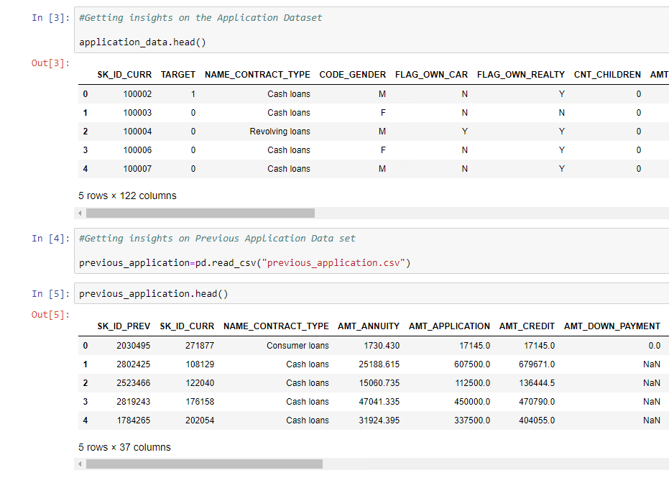
DATA SOURCING
Data is provided by UPGRAD Team
Data is provided in CSV Format , we have two data sets to analyze and provided the insights
Application.csv, Previous_application.csv are the two data sets . They consists of 122 columns and 37 columns respectively

Slide 8
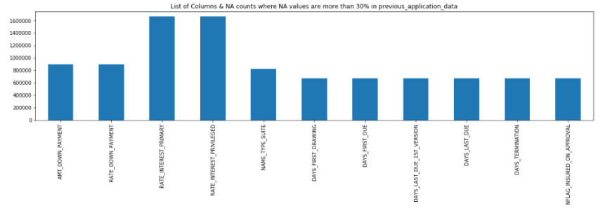
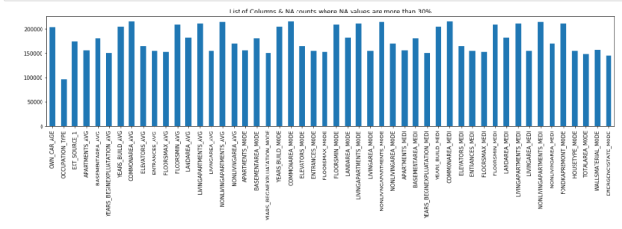
DATA CLEANING
Finding the columns which have more than 30% of the null values from both the available data sets
There are 50 columns which have null values more than 30% in their data in Application.csv
There are 11 columns which have null values more than 30% in their data in Application.csv
As part of our analysis we have to remove these columns as they affect our analysis because of insufficient data

Slide 9
HANDLING MISSING VALUES AND OUTLIERS FOR APPLICATION.CSV
All the null values in AMT_REQ_CREDIT_BUREAU* (6)columns can be filled with 0 because if the enquiry did not happen we can consider it to be 0
Calculate the percentage of rows in the remaining columns having null values.
Since the percentage of NAN values in "AMT_GOODS_PRICE" is very low it is ideal to remove the rows which have null values
Since box plot for EXT_SOURCE_2 shows mean is not at the center and also since only 2% of rows have NAN we can remove the rows instead replacing with values
Though boxplot for EXT_SOURCE_3 shows the mean is almost at the center but 19% of data has NAN values replacing with the MEAN is not ideal. Though the standard deviation seems to be very less, if we observe the mean values and maximum values the data in this column is between 0-1 and replacing it with mean would be a bad idea , so it is ideal to remove the rows with NA
With all necessary data cleaning techniques 80% of data is retrieved
NOTE: ALL THE DATA CLEANING IS CLEARLY MEANTIONED IN NOTEBOOK

Slide 10
HANDLING MISSING VALUES AND OUTLIERS IN PREVIOUS_APPLICATION.CSV
Since Box plot for AMT_ANNUITY, AMT_GOODS_PRICE shows there are so many outliers we can replace NAN values with median
Since Box plot for CNT_PAYMENT _PRICE there are LESS outliers we can replace NAN values with median
Since only 346 rows of NAME_CONTRACT_TYPE have XNA and frequency off cash loans is very high , we can replace XNA with mode
It is good to replace XNA with mode for CODE_REJECT_REASON'as there are very few XNA
NOTE:
ALL THE DATA CLEANING STEPS TAKEN ARE CLEARLY MENTIONED IN NOTEBOOK

Slide 11
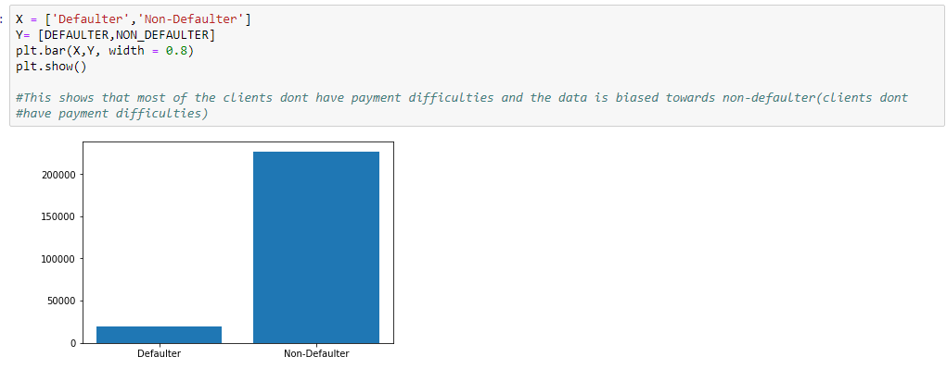
DATA ANALYSIS
Our focus is more on target variable as it is the main column which describes whether the applicant is "DEFAULTER" or not. We should analyze the target variable and see how the column is populated mainly since this might be used for ML Model (Target Variable should not be biased)
We have divided the data for Target=0 and Target=1 will be shown in Notebook

Slide 12

UNIVARIATE ANALYSIS - KEY INSIGHTS OF APPLICATION DATA
Revolving loans are higher for non-defaulters compared to defaulters.
The percentage of male defaulters are high compared to female defaulters.
When we consider the income group based on male and female, we can observe that when the income is low in both male and female categories, defaulting chance is there and hence we should be careful.
When we consider amount_credit grouped based on male and female, we can observe that when the amount_credit is low in both male and female categories, defaulting chance is there and we should be careful.
Based on the education , we cannot find much insights as both the plots followed the same pattern. But we can observe that people with higher education usually pay loans back and are non-defaulters
The defaulters are high when they are employed for less number of days compared to the employees who are employed for more number of days in both the categories of male and female

Slide 13
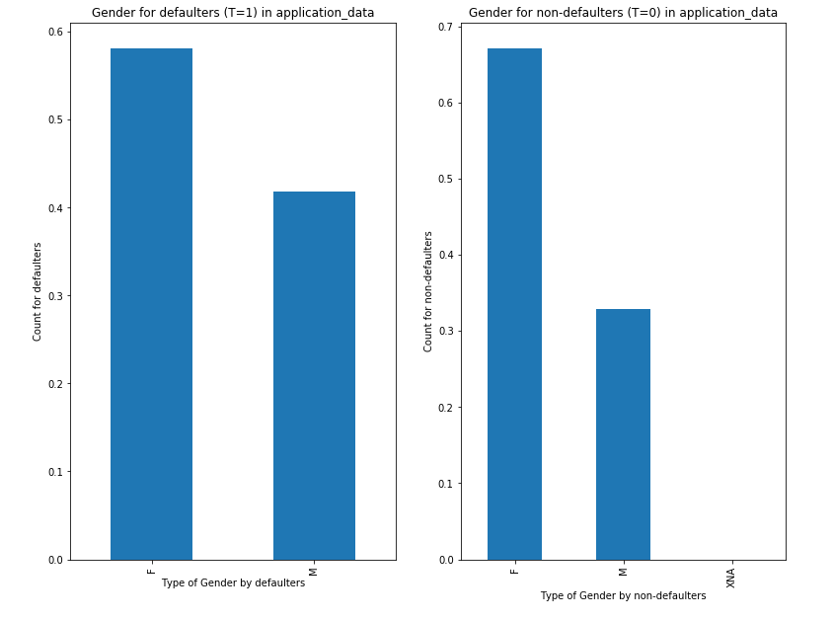
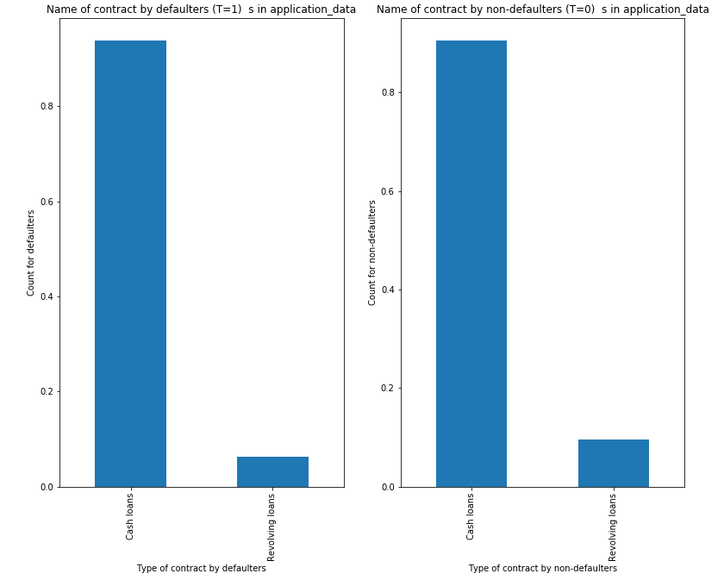
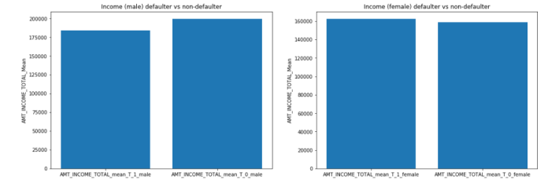
Note: More Graphical Representations are available in Notebook

Slide 14
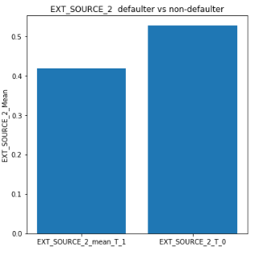
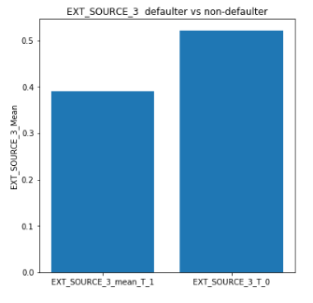
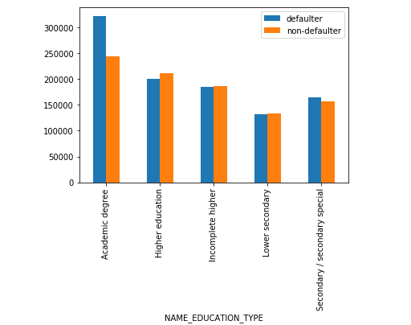
UNIVARIATE ANALYSIS – KEY INSIGHTS APPLICATION DATA
EXT_SOURCE_2 rating is high for non defaulters considering both the genders.
EXT_SOURCE_3 rating is high, for non defaulters considering both the genders.
DEF_60_CNT_SOCIAL_CIRCLE_mean is below 0.1 for non-defaulters , so this metric can be looked closely before giving loans.

Slide 15
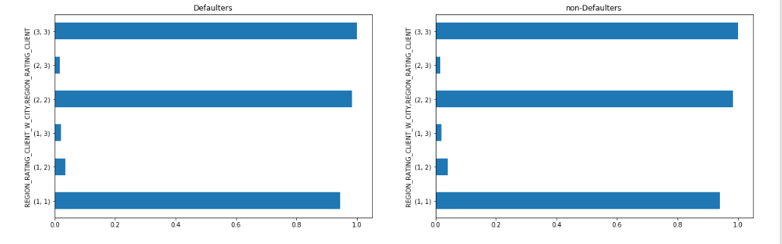
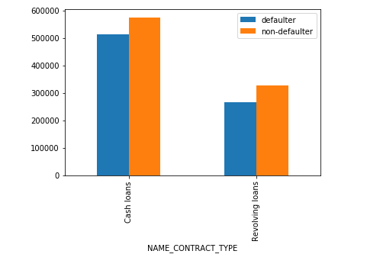
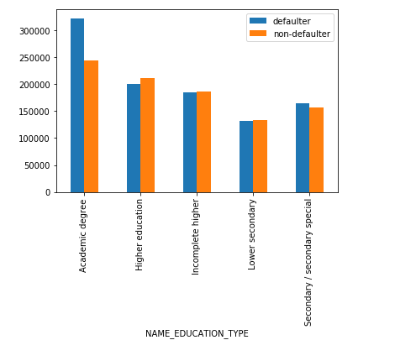
BIVARIATE & MULTIVARIATE ANALYSIS-Key Insights Application Data
Though the people have academic degree and earn high, they are high percentage of defaulters compared to non-defaulters .
REGION_RATING_CLIENT_W_CITY,REGION_RATING_CLIENT_W_CITY are highly correlated , usually both have same rating.
In both the cash loans and revolving loans, mean is high for "AMT_GOODS_PRICE" incase of non-defaulters when compared to defaulters

Slide 16
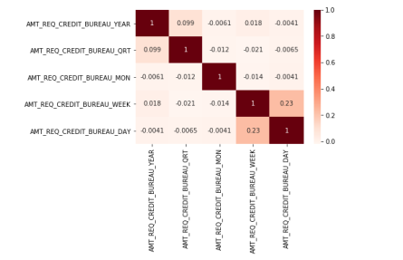
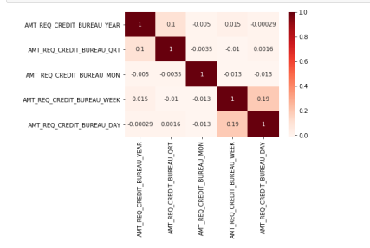
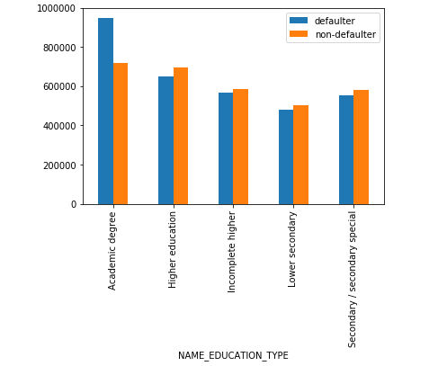
BIVARIATE AND MULTIVARIATE ANALYSIS APPLICATION DATA
AMT_CREDIT OF PEOPLE HAVING ACADEMIC DEGREE IS SIGNIFICANTLY HIGH AMONG THE DEFAULTERS
In AMT_BEAUREAU both defaulter and non defaulter followed same pattern

Slide 17
UNI-VARIATE ANALYSIS - KEY INSIGHTS PREVIOUS APPLICATION DATA
We classified the status column 'Refused' as 1 and 'Approved' as 0 and stored in Target and started analyzing.
Most of the loans have been rejected when they apply for cash loans in all the previous applications. We can use this variable while giving the loans for present applications.
There is a clear significant difference in means for AMT_ANNUITY between defaulter and non-defaulter. Lower for non-defaulters.
There is a clear significant difference in means for AMT_APPLICATION between defaulter and non-defaulter. Lower for non-defaulters.
Most of the non-defaulters apply loans during Saturday and Sunday(weekends), whereas for defaulters they usually apply during week days

Slide 18
BI-VARIATE AND MULTIVARIATE PREVIOUS APPLICATION
From our previous analysis we have seen that cash loans have most of the defaulters compared to consumer loans. But in consumer loans, when you consider country wide -consumer loans, the defaulters are high in number. Hence while giving the loan it is better to consider CHANNEL_TYPE also
Our previous analysis is to make a close obsevance for cash loans. In cash loans, if the NAME_YIELD_GROUP is from middle we can consider the client to give loan.
In case of cash loans, if client is refreshed or a new applicant, you can consider him to provide loan

Slide 19
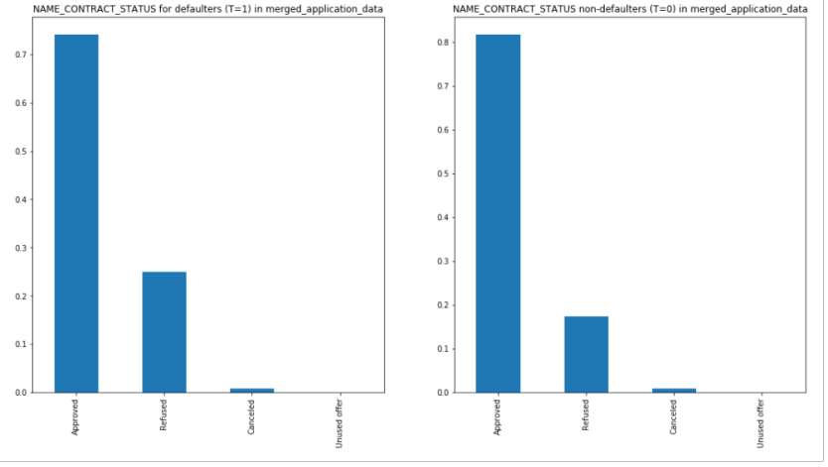
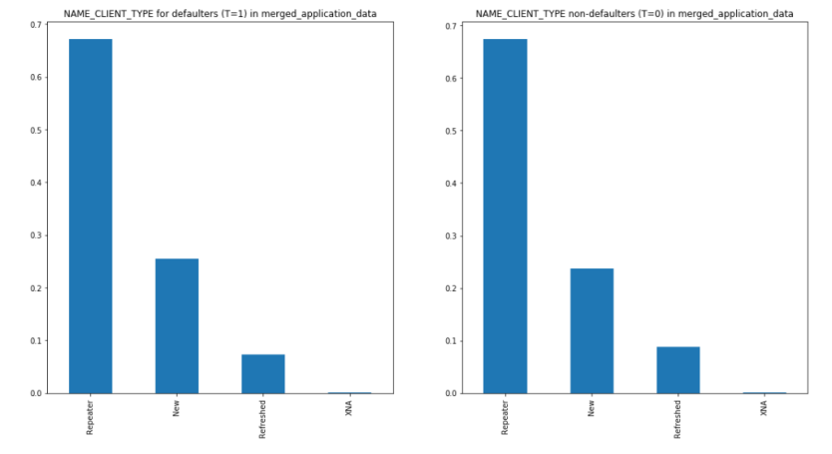
MERGED DATA ANALYSIS - UNIVARIATE
There are lots of defaulters in present applications whose loans are approved on previous application, we cannot just approve the present applications based on previous applications (status)
We have seen in previous application data that loans for new applicants are approved(highly). But when you consider the current applications, the % of defaulters are almost same as non-defaulters. With this insight banks should properly evaluate new applications or change the procedure to evaluate new applications.

Slide 20
BI-VARIATE AND MULTI-VARIATE MERGED DATA
Repeated Applications have good number of non-defaulters if their education level is higher than secondary .
When you consider new loans banks should be careful for any level of education level.
In academic degree when we give loan to low-normal in NAME_YIELD_GROUP, you should be careful as there are many defaulters and there are no defaulters in low-action.
AMT_ANNUITY_X,AMT_ANNUITY_Y are positively correlated but their correlation value is less, similarly for AMT_GOODS_PRICE_X,AMT_GOODS_PRICE_Y

Slide 21
KEY INSIGHTS & OUR RECOMMENDATIONS
Upon analysis of the “TARGET” column, we come to a conclusion that most of the clients don’t have payment difficulties and the data is biased towards non-defaulters
Income group based on gender gives an indication that when the income is low, defaulting chances are high.
Applicants with higher education usually pay loans back and are generally non-defaulters, but when we tried to add income variable , high income with higher education have good percentage of defaulters, so banks should be careful .
Days Employed gives a fair idea on number of defaulters – Higher the days of employment, lower is the chance of defaulting and vice versa
EXT_SOURCE rating is high for non-defaulters in both the cases, banks can consider their rating before giving loans.
It is a clear conclusion that most of the defaulter’s loans have been rejected when they apply for cash loans in all the previous applications.
Consider AMT_ANNUITY, AMT_GOODS_PRICE & AMT_APPLICATION while giving loans, as there is a significant difference in means for both defaulters and non-defaulters, they play a crucial role in predicting if the applicants to be defaulters or non-defaulters

Slide 22
KEY INSIGHTS & OUR RECOMMENDATIONS
Day of the week can also give some information on defaulting as non-defaulters apply loan on weekends and defaulters tend to apply for loan on weekdays
If the client is a repeater you need to look into various factors. But if he/she is a new applicant and once the base factors are satisfied, chances of client being a defaulter is less as per the data of previous application.
SELLERPLACE_AREA is inversely proportional to defaulting.
We have seen that cash loans have most of the defaulters compared to consumer loans. But in consumer loans, when you consider country wide -consumer loans, the defaulters are high in number. Hence while giving the loan it is better to consider CHANNEL_TYPE also.
In cash loans, if the name_yield_group is from middle we can consider the client to give loan.
We have seen in previous application data that loans for new applicants are approved(highly). But when you consider the current applications, the % of defaulters are almost same as non-defaulters. It means if clients previous application is approved , you should be careful if he can pay both the loans. In this case try looking for term of previous application, if it is less you can consider present application to give loan
All the repeaters with education higher than secondary have good number of non-defaulters. When you consider new loans you should be careful for any education level.

Slide 23
LIST OF VARIABLES WHICH CAN BE USED FOR DEVELOPING A MACHINE LEARNING MODEL IN THE FUTURE
Sl. No | Variable
1 | AMT_INCOME_TOTAL
2 | NAME_EDUCATION_TYPE
3 | DAYS_EMPLOYED
4 | NAME_CONTRACT_TYPE
5 | AMT_ANNUITY
6 | AMT_GOODS_PRICE
7 | AMT_APPLICATION
8 | SELLERPLACE_AREA
Sl. No | Variable
9 | OCCUPATION_TYPE
10 | DAYS OF THE WEEK
11 | ORGANIZATION_TYPE
12 | AMT_CREDIT
13 | NAME_CASH_LOAN_PURPOSE
14 | NAME_YIELD_GROUP
15 | NAME_CONTRACT_TYPE

Slide 24


